Slide 1

Chapter 4 Requirement Engineering
4.1 Functional and non-functional requirements
4.2 Requirements engineering processes
4.3 Requirements elicitation
4.4 Requirements specification
4.5 Requirements validation
4.6 Requirements change
Summary

Slide 2
Learning objectives
Understand the concepts of user and system requirements
Understand the difference between functional and non-functional requirements
Understand main requirements activities
Understand the requirements management is necessary

Slide 3
Types of requirements
User requirements
Statements in natural language plus diagrams of the services the system provides and its operational constraints. Written for customers.
System requirements
A structured document setting out detailed descriptions of the system’s functions, services and operational constraints. Defines what should be implemented so may be part of a contract between client and contractor.

Slide 4
Readers of requirements specification

Slide 5
4.1 Functional and non-functional requirements
Functional requirements
Statements of services the system should provide, how the system should react to particular inputs and how the system should behave in particular situations.
Non-functional requirements
Constraints on the services or functions offered by the system such as timing constraints, constraints on the development process, standards, etc.
Often apply to the system as a whole rather than individual features or services.
Functional system requirements should describe the system services in detail.

Slide 6
cont.1
4.1 Functional and non-functional requirements

Slide 7
end
4.1 Functional and non-functional requirements
Metrics for specifying nonfunctional requirements
Property | Measure
Speed | Processed transactions/second User/event response time Screen refresh time
Size | Mbytes Number of ROM chips
Ease of use | Training time Number of help frames
Reliability | Mean time to failure Probability of unavailability Rate of failure occurrence Availability
Robustness | Time to restart after failure Percentage of events causing failure Probability of data corruption on failure
Portability | Percentage of target dependent statements Number of target systems

Slide 8
4.2 Requirements engineering process
A spiral view of the requirements engineering process

Slide 9
4.3 Requirements elicitation

Slide 10
cont.1
4.3 Requirements elicitation
(1) Interviewing
Types of interview
Closed interviews based on pre-determined list of questions
Open interviews where various issues are explored with stakeholders.
Effective interviewing
Be open-minded, avoid pre-conceived
Prompt the interviewee to get discussions going using a springboard question, a requirements proposal, or by working together on a prototype system.

Slide 11
cont.2
4.3 Requirements elicitation
(2) Ethnography
Ethnography is the systematic study of people and cultures.
An ethnography is a means to represent graphically and in writing the culture of a group.

Slide 12
end
4.3 Requirements elicitation
(3) Stories and scenarios
Scenarios and user stories are real-life examples of how a system can be used.
Stories and scenarios are a description of how a system may be used for a particular task.
Because they are based on a practical situation, stakeholders can relate to them and can comment on their situation with respect to the story.

Slide 13
4.4 Requirements specification
The process of writing down the user and system requirements in a requirements document.
User requirements have to be understandable by end-users and customers who do not have a technical background.
System requirements are more detailed requirements and may include more technical information.
The requirements may be part of a contract for the system development
It is therefore important that these are as complete as possible.

Slide 14
cont.1
4.4 Requirements specification
Ways of writing a system requirements specification
Notation | Description
Natural language | The requirements are written using numbered sentences in natural language. Each sentence should express one requirement.
Structured natural language | The requirements are written in natural language on a standard form or template. Each field provides information about an aspect of the requirement.
Design description languages | This approach uses a language like a programming language, but with more abstract features to specify the requirements by defining an operational model of the system. This approach is now rarely used although it can be useful for interface specifications.
Graphical notations | Graphical models, supplemented by text annotations, are used to define the functional requirements for the system; UML use case and sequence diagrams are commonly used.
Mathematical specifications | These notations are based on mathematical concepts such as finite-state machines or sets. Although these unambiguous specifications can reduce the ambiguity in a requirements document, most customers don’t understand a formal specification. They cannot check that it represents what they want and are reluctant to accept it as a system contract

Slide 15
cont.2
4.4 Requirements specification
Use cases
Use-cases are a way of describing interactions between users and a system using a graphical model and a structured text (Unified Modelling Language - UML).
A set of use cases should describe all possible interactions with the system.
UML sequence diagrams may be used to add detail to use-cases by showing the sequence of event processing in the system.

Slide 16
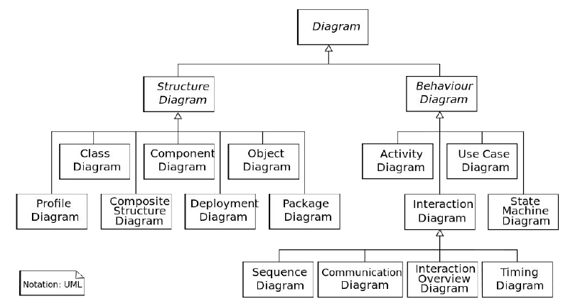
cont.3
4.4 Requirements specification
UML diagrams

Slide 17
cont.4
4.4 Requirements specification
Use cases for Mentcare system

Slide 18
cont.5
4.4 Requirements specification
Requirements documentation
Chapter | Description
Preface | This should define the expected readership of the document and describe its version history, including a rationale for the creation of a new version and a summary of the changes made in each version.
Introduction | This should describe the need for the system. It should briefly describe the system’s functions and explain how it will work with other systems. It should also describe how the system fits into the overall business or strategic objectives of the organization commissioning the software.
Glossary | This should define the technical terms used in the document. You should not make assumptions about the experience or expertise of the reader.
User requirements definition | Here, you describe the services provided for the user. The nonfunctional system requirements should also be described in this section. This description may use natural language, diagrams, or other notations that are understandable to customers. Product and process standards that must be followed should be specified.
System architecture | This chapter should present a high-level overview of the anticipated system architecture, showing the distribution of functions across system modules. Architectural components that are reused should be highlighted.

Slide 19
end
4.4 Requirements specification
Chapter | Description
System requirements specification | This should describe the functional and nonfunctional requirements in more detail. If necessary, further detail may also be added to the nonfunctional requirements. Interfaces to other systems may be defined.
System models | This might include graphical system models showing the relationships between the system components and the system and its environment. Examples of possible models are object models, data-flow models, or semantic data models.
System evolution | This should describe the fundamental assumptions on which the system is based, and any anticipated changes due to hardware evolution, changing user needs, and so on. This section is useful for system designers as it may help them avoid design decisions that would constrain likely future changes to the system.
Appendices | These should provide detailed, specific information that is related to the application being developed; for example, hardware and database descriptions. Hardware requirements define the minimal and optimal configurations for the system. Database requirements define the logical organization of the data used by the system and the relationships between data.
Index | Several indexes to the document may be included. As well as a normal alphabetic index, there may be an index of diagrams, an index of functions, and so on.

Slide 20
4.5 Requirements validation
Validity. Does the system provide the functions which best support the customer’s needs?
Consistency. Are there any requirements conflicts?
Completeness. Are all functions required by the customer included?
Realism. Can the requirements be implemented given available budget and technology
Verifiability. Can the requirements be checked?

Slide 21
end
4.5 Requirements validation
Requirements validation techniques
Requirements reviews
Systematic manual analysis of the requirements.
Prototyping
Using an executable model of the system to check requirements.
Test-case generation
Developing tests for requirements to check testability.

Slide 22
4.6 Requirements change
Requirements evolution

Slide 23
end
4.6 Requirements change
Requirements change management

Slide 24
Summary
The requirements engineering process is an iterative process that includes requirements elicitation, specification and validation.
Requirements elicitation is an iterative process that can be represented as a spiral of activities – requirements discovery, requirements classification and organization, requirements negotiation and requirements documentation.
You can use a range of techniques for requirements elicitation including interviews and ethnography. User stories and scenarios may be used to facilitate discussions.

Slide 25
Summary
end
Requirements specification is the process of formally documenting the user and system requirements and creating a software requirements document.
The software requirements document is an agreed statement of the system requirements. It should be organized so that both system customers and software developers can use it.

